Slide 1

Stat Learners

Slide 2
Red Wine Quality Data
The aim of the data analysis is to use the supervised method to analyze the red wine dataset.
Our goal is to characterize the relationship between wine quality and its analytical characteristics.
The target variable is the quality determined by expert evaluation. It can be considered as discrete categories so that this problem can be formulated as classification or regression.
We will develop models of wine quality for red wine variant to determine whether quality of red wine is predominantly affected by its chemical properties.
The variables or the chemical properties that are used are:
Acidity
Alcohol
Sulphur
Sugar Content
Chlorides
Ph
Density
Quality
Citric Acid
Sulphur Dioxide
Volatile Acidity

Slide 3
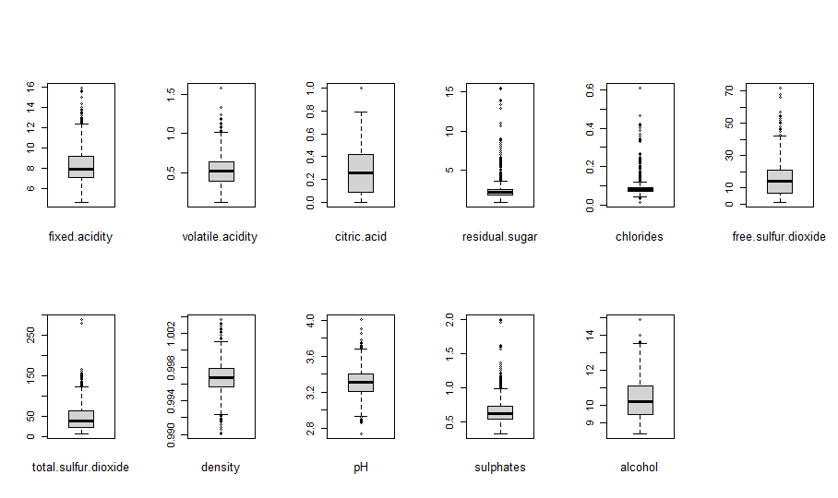
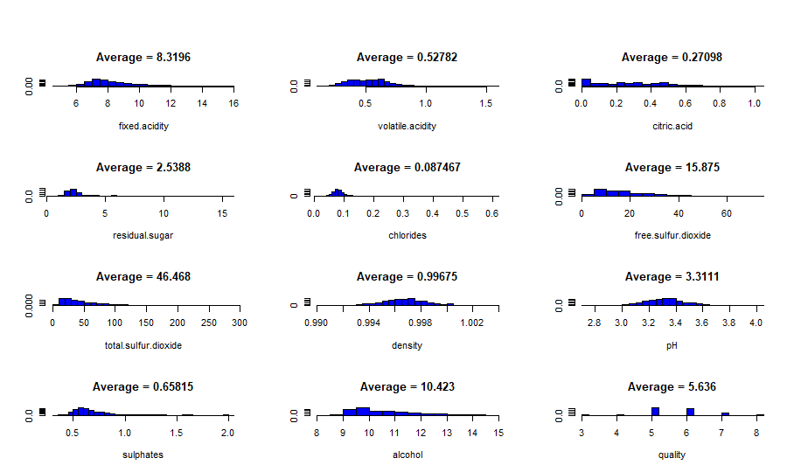
Data Preparation
The red wine dataset has 1599 observations, 11 predictors and 1 outcome (quality). All of the predictors are numeric values, outcomes are integer.
The summary stats shows that most of the variables has wide range compared to the IQR, which may indicate spread in the data and the presence of outliers. We investigate further by producing boxplots for each of the variables
For each variables, we consider observations that lie outside 1.5 * IQR as outliers

Slide 4
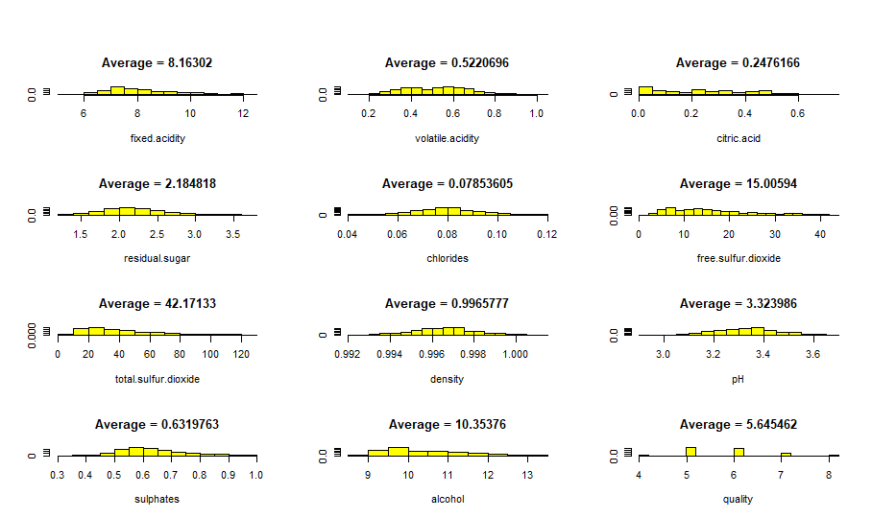
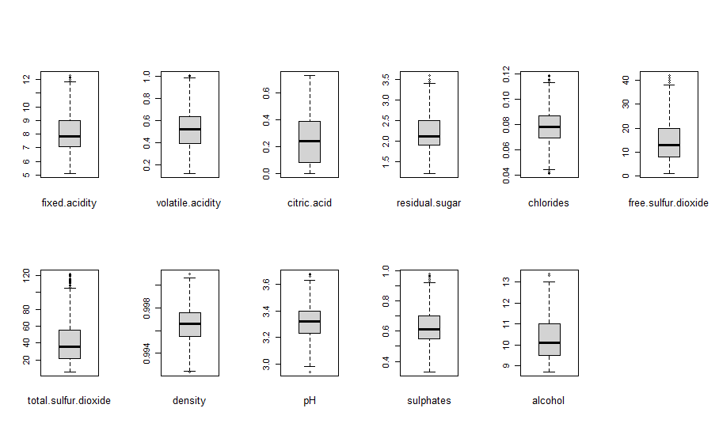
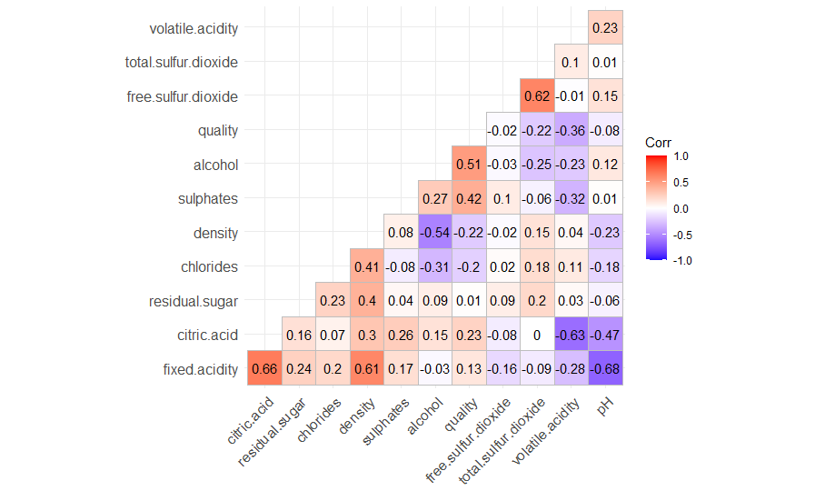
Outlier detection
By removing the outliers, the dataset size reduced to 1179 observations.
We observe that the outliers have reduced and the distribution graph is not left skewed.
The correlation graph confirms strong between fixed.acidity/density and fixed.acidity/pH.

Slide 5
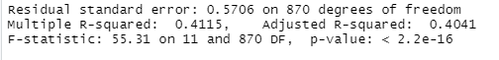
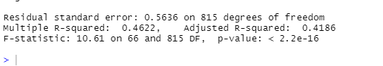
Linear Regression
The data was classified to train data(884) and test data (295) with 11 predictors.
The outliers were removed from the data after the classification. The regression model provided a result:
Since the data was yet variable, the outliers were removed again. A squared linear regression was performed and the below results were provided:
We performed various models like ridge regression, polynomial regression, the results were unsatisfactory, henceforth we decided to only discuss the Linear regression.

Slide 6
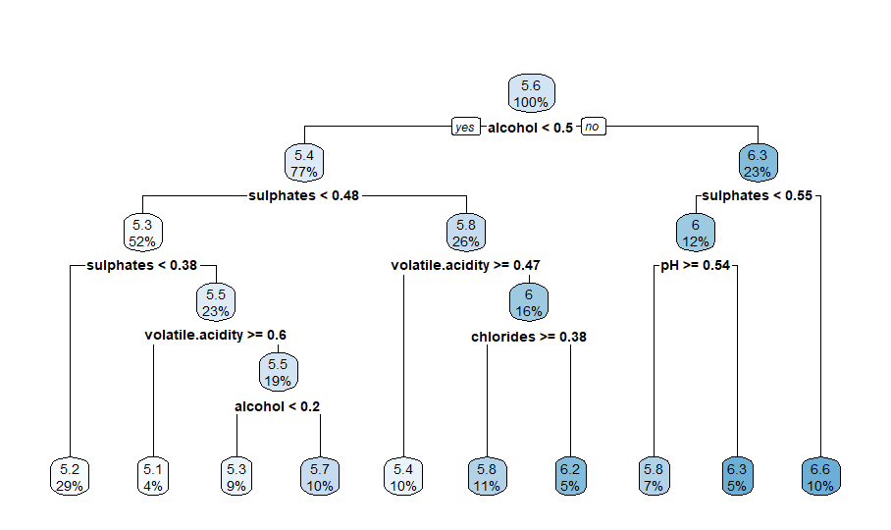
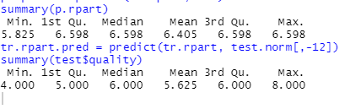
Regression Tree
The regression tree predicts the quality of wine, and a comparison is drawn between the predicted and the actual data:
The results are not really bad for estimating the quality of the wine.

Slide 7
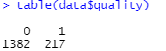
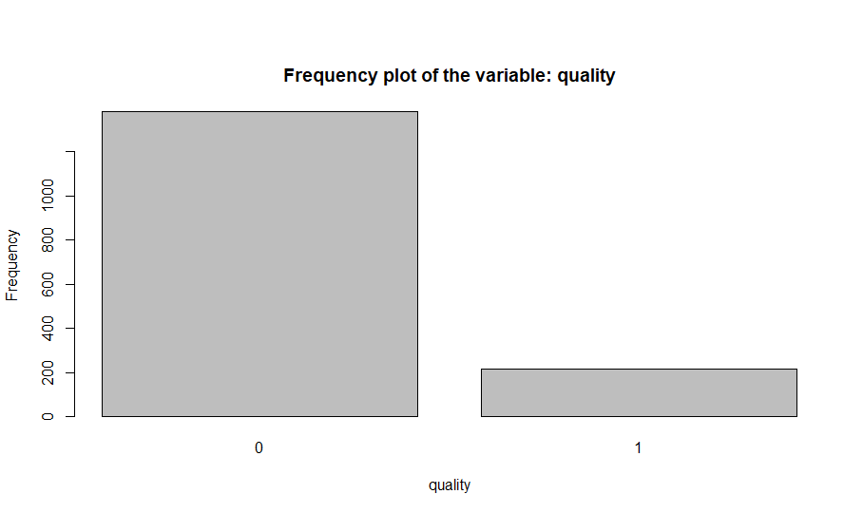
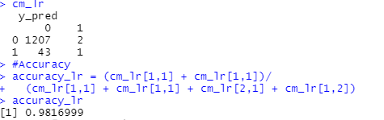
Logistic Binary Regression
The quality of wine is classified in 1’s and 0’s on based of the rating, if quality is less than or equal to 7 then 0 else 1:
Confusion matrix was performed to categorise
the prediction against the actual ones:
The accuracy is 98.1699 percent.

Slide 8
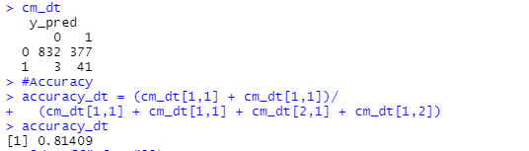
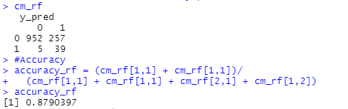
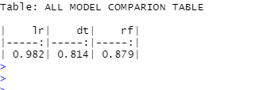
Conclusion Supervised Learning
Decision tree and random forest were also performed on the data.
The results were compared and below is comparison table:
As per our analysis Logistic Regression provides more accuracy compared to other models to predict the quality of the wine.

Slide 9
Unsupervised

Slide 10
Wholesale customers dataset
The data set refers to clients of a wholesale distributor. It includes the annual spending in monetary units (m.u.) on diverse product categories
We used unsupervised method to analyze the Wholesale customers dataset.
We are trying to do clustering using K-means method and find the optimal number of cluster using (k) using Silhouette Method.
The aim of this problem is to segment the clients of a wholesale distributor based on their annual spending on diverse product categories, like milk, grocery, region, etc.
Attribute's information:
FRESH: annual spending (m.u.) on fresh products (Continuous);
MILK: annual spending (m.u.) on milk products (Continuous);
GROCERY: annual spending (m.u.)on grocery products (Continuous);
FROZEN: annual spending (m.u.)on frozen products (Continuous)
DETERGENTS_PAPER: annual spending (m.u.) on detergents and paper products (Continuous)
DELICATESSEN: annual spending (m.u.)on and delicatessen products (Continuous);
CHANNEL: customers Channel - Horeca (Hotel/Restaurant/Cafe) or Retail channel (Nominal)
REGION: customers Region Lisnon, Oporto or Other (Nominal)

Slide 11
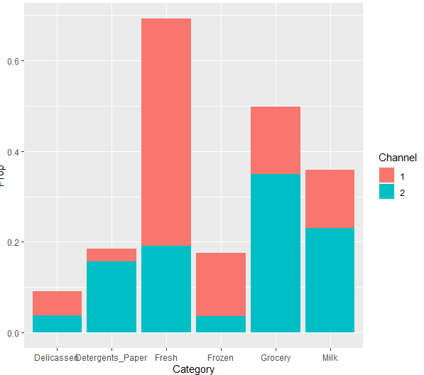
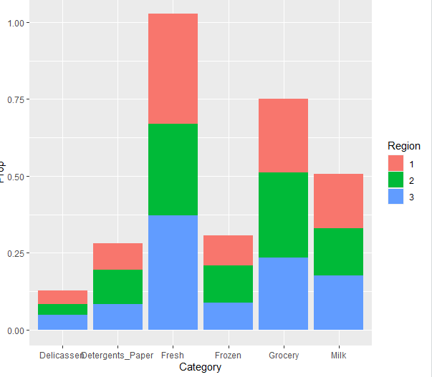
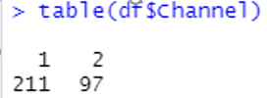
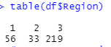
Data Preparation
The Wholesale customer dataset has 440 observations, 8 attributes.
We categorised the data based on two channel and three regions and calculated the amount spent for items under each channel and region
The data was distributed as in graph
Channel1:211 observation
Channel2:97 observations
Region1: 56 observations
Region2:33 observations
Region 3:219 observations
Grocery and fresh items are top sellers

Slide 12
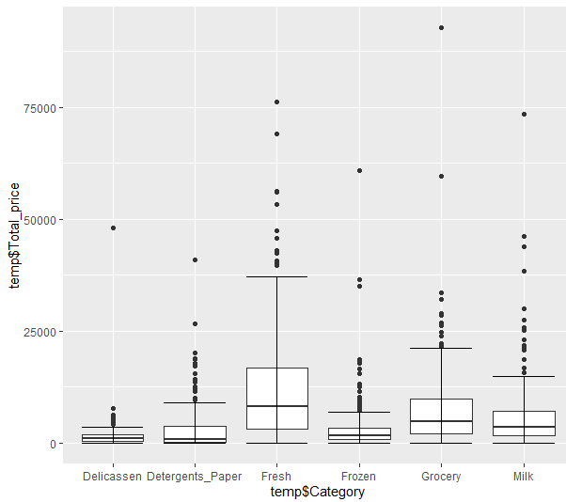
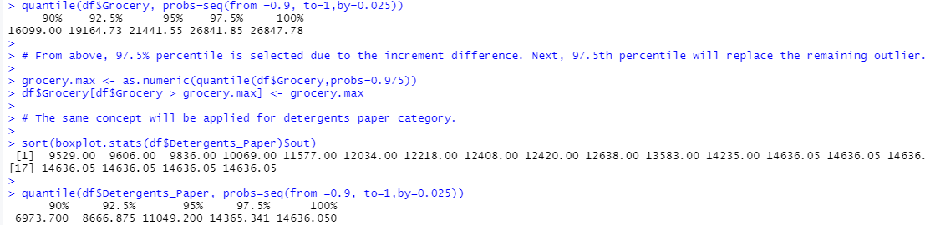
Removing outliers
As per the boxplot there are few outliers present in the dataset.
As per the correlation matrix there is a strong correlation between
grocery and detergent_paper categories so applying outliers to them.
Removing outliers from dataset with values above
97.5% percentile in detergents_paper and grocery categories

Slide 13
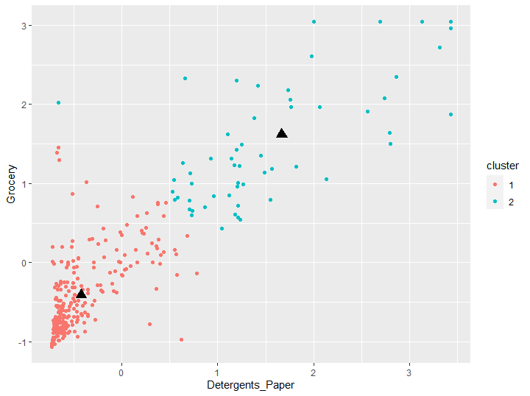
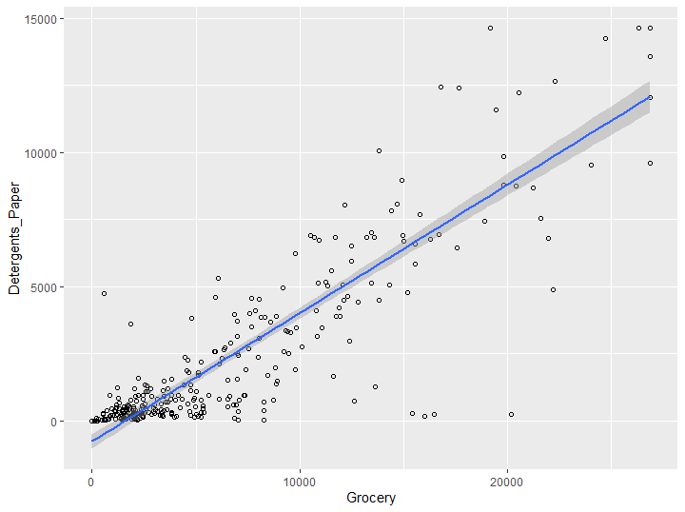
K Means Clustering
As you can see this plot illustrate 2 clusters based on the 2 variables, Grocery and Detergents_paper based on k means algorithm. Next, examine the summary of the k mean object result.
Clustering validation is done next:
Internal cluster validation
External cluster validation
Relative cluster validation

Slide 14
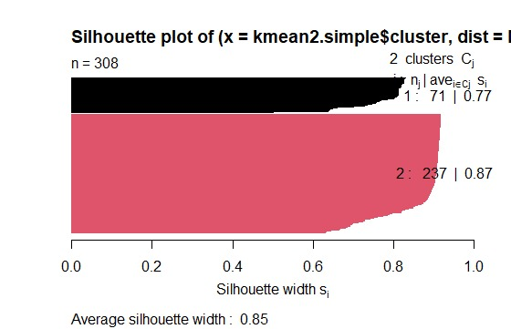
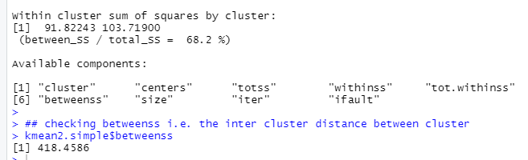
Internal cluster validation
Internal cluster validation plot show the following:
Cluster 1: 0.77 (Good as it is close to 1)
Cluster 2: 0.88 (Good as it is close to 1)
The internal cluster quality evaluation is good as shown in the plot.
Goodness of the classification k-means: 68.2% (which is a good fit)
Inter cluster distance i.e. Between the Clusters is 418.4586

Slide 15
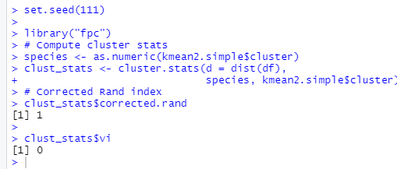
External cluster validation
It measures the extent to which cluster
labels match externally supplied class labels.
Above result shows there is no external class label used as we do not know the result beforehand. As such, findings is perfect result

Slide 16
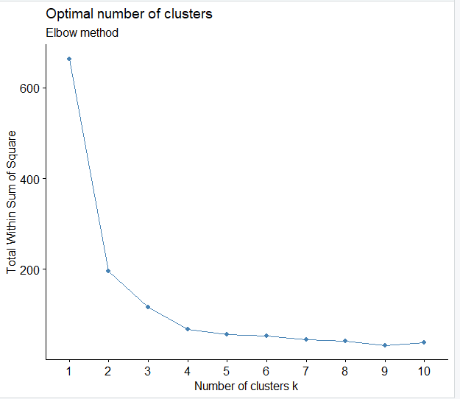
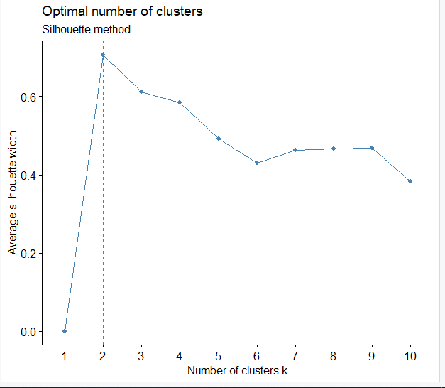
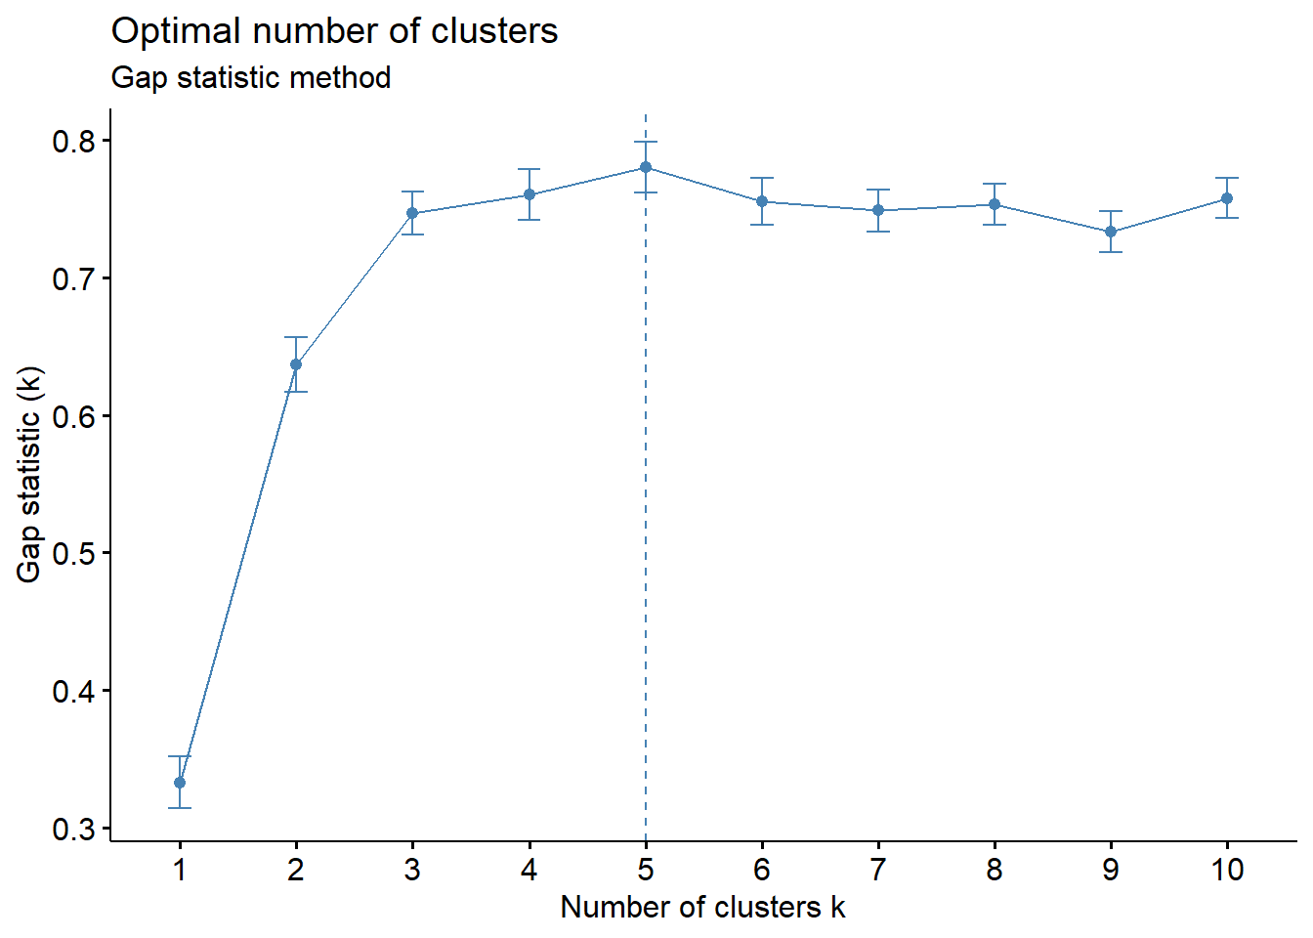
(Relative Cluster Validation) ANALYSIS AND MODELLING-ELBOW AND SILHOUETTE & GAP STATISTIC METHODS
In Elbow method and Silhouette method we found 2 clusters but In Gap Statistic method we found 5 clusters as you can see in the graph.
Since two methods showing 2 clusters so we chose 2.

Slide 17
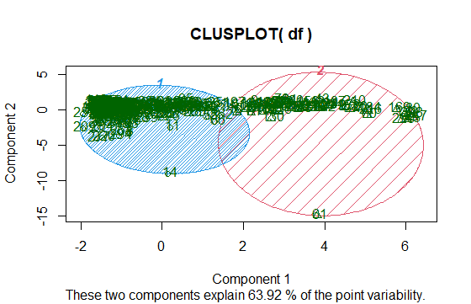
Interpretation of the results
Our analysis show that more than 63% of information about the multivariate data is captured by this plot of component 1 and 2.

Slide 18
Conclusion
We used two variables in our alogrithm i.e. Grocery and Detergent paper to run K-means.
To find the optimal number of clusters we used three approaches elbow method, Average Silhouette method, Gap Statistic method
Goodness of the classification k-means:68.2% (which is a good fit) (Random)
Inter cluster distance i.e. Between the Clusters is 418.4586
Cluster 1 price average is higher than cluster 2 based on the centroid mean.
K means clustering with clusters of sizes 62 and 246
Total within the clusters the sum of the squares is 195.5414

Slide 19
CNN

Slide 20
The CIFAR-10 dataset description
The CIFAR-10 dataset consists of 60000 32x32 colour images in 10 classes, with 6000 images per class. There are 50000 training images and 10000 test images.
The dataset is divided into five training batches and one test batch, each with 10000 images. The test batch contains exactly 1000 randomly-selected images from each class. The training batches contain the remaining images in random order, but some training batches may contain more images from one class than another. Between them, the training batches contain exactly 5000 images from each class.

Slide 21
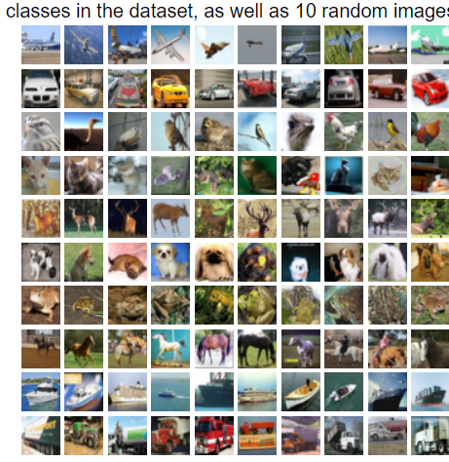
Some important characteristics of the CIFAR-10 dataset
Images are coloured in CIFAR-10 as compared to the black and white datasets
Each image is 32 x 32 pixel
50,000 training images and 10,000 testing images

Slide 22
Phases
1) Pre-process Data phase:
Getting the data
Pre-processing functions
2) CNN phase:
Building the network
Training the network
Model Testing

Slide 23

Pre-process functions
Normalization:
Transforming image X into a NumPy array
One Hot Encoded:
Labelling the images into 0 or 1, by indexing the classes, giving 1 to the class and 0 to the rest of the classes.
Randomize the data:
Making sure that the data is as random as possible, to insure maximum randomization

Slide 24
Why CNN?
A Convolutional Neural Network is a powerful neural network that uses filters to extract features from images. It also does so in such a way that position information of pixels is retained.
Neural networks have led to huge breakthroughs in machine learning and are the fundamental reason behind the deep learning boom. Neural networks like CNNs have proved particularly successful in working with image data and ever since being used in ImageNet competition in 2012, they have been the frontrunners in research and industry while dealing with images.

Slide 25
CNN Building Blocks
Convolutional Layer
Pooling Layer
ReLU Layer
Fully Connected Layer
Loss Layer

Slide 26

Training the neural net and Testing the Model
Single Optimization
Hyperparameters
Training on a single CIFAR-10 Batch
Fully Trained Model
Accuracy: 84.4%
SoftMax Predictions

Slide 27
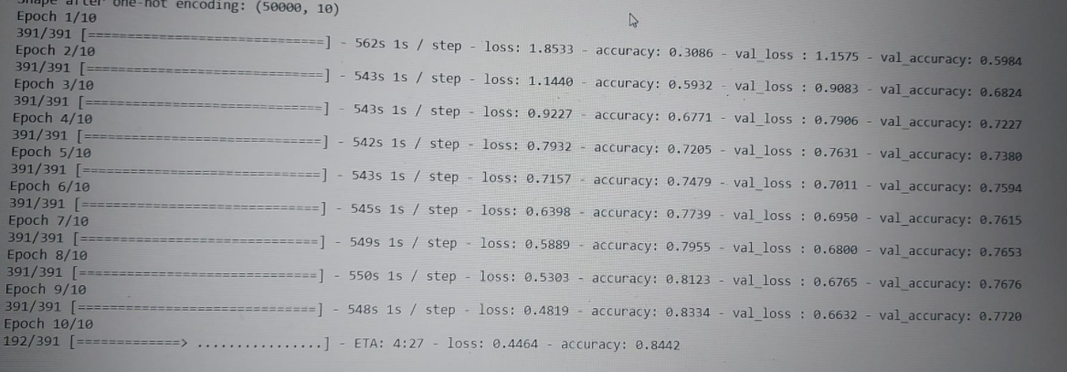
Training and validation accuracy across epochs
our max validation accuracy by using a simple neural network model was around 84.4%

Slide 28
CONCLUSION FOR CNN
We used the keras library of Python for the implementation of this project.
We created a CNN model with several layers and trained the model. Finally, we tested the classification model by giving some random images downloaded from the Internet.
Our image classifier predicted the results with an accuracy of 84.4 percentage.

Slide 29


